Slide 1
Electronic Devices
Final Term Lecture - 04
Reference book:
Electronic Devices and Circuit Theory (Chapter-6)
Robert L. Boylestad and L. Nashelsky , (11th Edition)

Slide 2
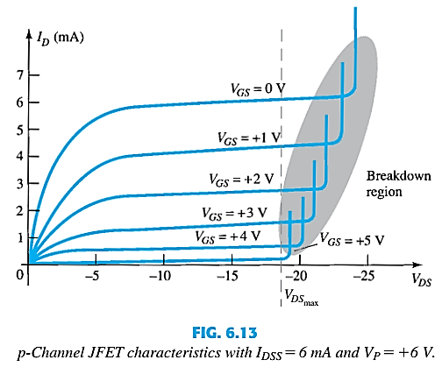
P-CHANNEL JFET CHARACTERISTICS
As V_{GS} increases more positively:
The depletion zone increases
I_{D} decreases (I_{D} < I_{DSS})
Eventually I_{D} = 0A
Also note that at high levels of V_{DS} the JFET reaches a breakdown situation. I_{D} increases uncontrollably if V_{DS} > V_{DSmax}.

Slide 3
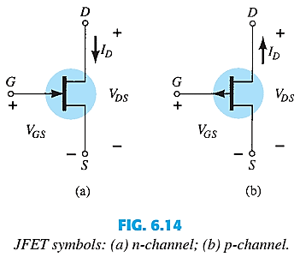
JFET SYMBOLS

Slide 4
SUMMARY TILL NOW
The maximum current is defined as I_{DSS} and occurs when V_{GS} = 0 V and V_{DS} ≥ |V_{p}|, as shown in Fig. 6.15a .
For gate-to-source voltages V_{GS} is less than (more negative than) the pinch-off level, the drain current is 0 A (I_{D} = 0 A ), as in Fig. 6.15b .
For all levels of V_{GS} between 0 V and the pinch-off level, the current I_{D} will range between I_{DSS} and 0 A, respectively, as in Fig. 6.15c.
A similar list can be developed for p-channel JFETs.

Slide 5
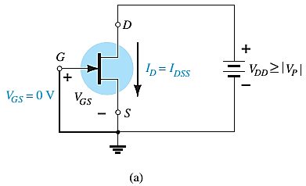
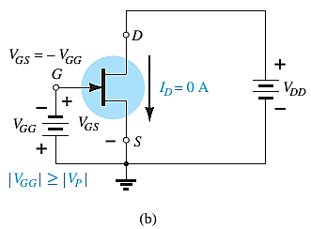
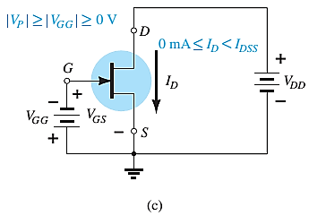

SUMMARY TILL NOW

Slide 6
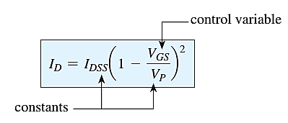
JFET TRANSFER CHARACTERISTICS
The transfer characteristic of input-to-output is not as straight forward in a JFET as it was in a BJT.
In a BJT, β indicated the relationship between I_{B} (input) and I_{C} (output).
In a JFET, the relationship of V_{GS} (input) and I_{D} (output) is a little more complicated (Shockley’s equation):

Slide 7
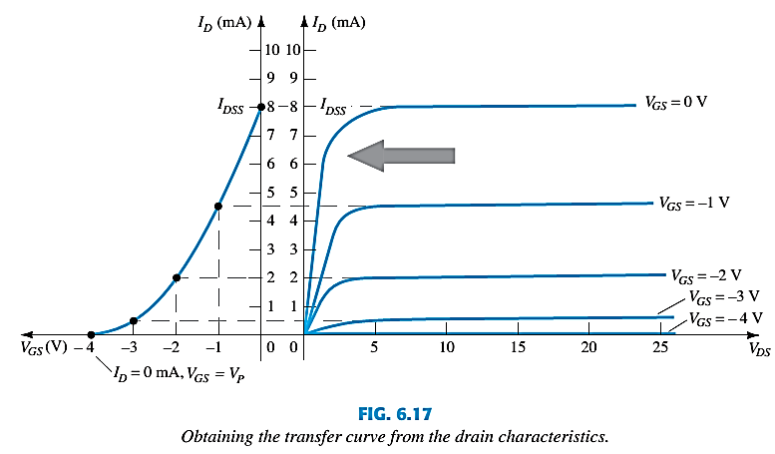
TRANSFER CURVE

Slide 8
PLOTTING THE TRANSFER CURVE
Using I_{DSS} and V_{p} (V_{GS(off)}) values found in a specification sheet, the Transfer Curve can be plotted using these 3 steps:
Step 1:
Solving for V_{GS} = 0V:
Step 2:
Solving for V_{GS} = V_{p} (V_{GS(off)}):
Step 3:
Solving for V_{GS} = 0V to V_{p}:

Slide 9
SHORTHAND METHOD
V_{GS} | I_{D}
0 | I_{DSS}
0.3V_{P} | I_{DSS}/2
0.5V_{P} | I_{DSS}/4
V_{P} | 0mA
V_{GS} | I_{D}
0 | I_{DSS}
0.3V_{P} | I_{DSS}/2
0.5V_{P} | I_{DSS}/4
V_{P} | 0mA
When VGS = 0 V, ID = IDSS
When VGS = VP, ID = 0 mA

Slide 10
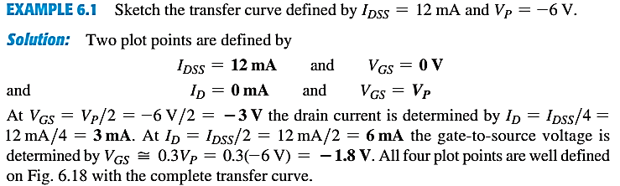
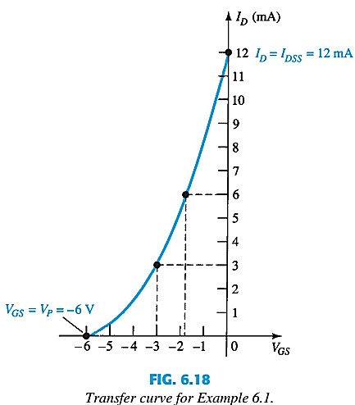
EXAMPLE

Slide 11
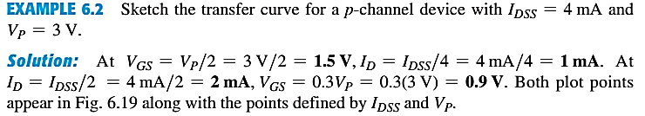
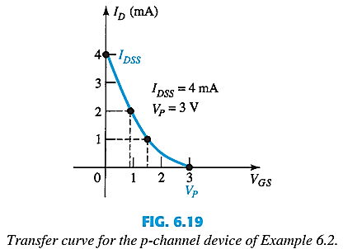
EXAMPLE

Slide 12
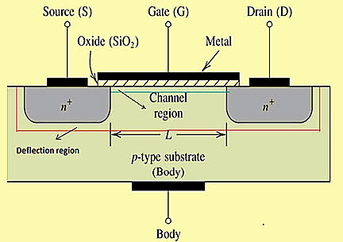
MOSFETs
MOSFETs have characteristics similar to JFETs and additional characteristics that make them very useful.
There are 2 types:
Depletion-Type MOSFET
Enhancement-Type MOSFET

Slide 13
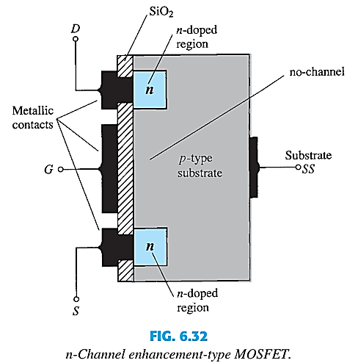
ENHANCEMENT-TYPE MOSFET CONSTRUCTION
The Drain (D) and Source (S) connect to the to n-doped regions.
The Gate (G) connects to the p-doped substrate via a thin insulating layer of SiO2.
There is no channel. The n-doped material lies on a p-doped substrate that may have an additional terminal connection called SS.
In summary, therefore, the construction of an enhancement-type MOSFET is quite similar to that of the depletion-type MOSFET, except for the absence of a channel between the drain and source terminals.

Slide 14
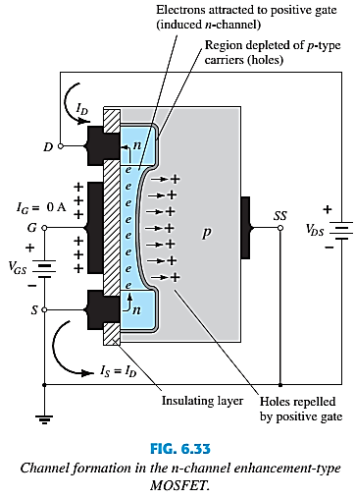
CONTINUED…
As V_{GS} increases in magnitude, the concentration of electrons near the SiO2 surface increases until eventually the induced n-type region can support a measurable flow between drain and source.
The level of V_{GS} that results in the significant increase in drain current is called the threshold voltage and is given the symbol V_{T}.
Since the channel is nonexistent with V_{GS}=0 V and “enhanced” by the application of a positive gate-to-source voltage, this type of MOSFET is called an enhancement-type MOSFET.

Slide 15

CONTINUED…
As V_{GS} is increased beyond the threshold level, the density of free carriers in the induced channel will increase, resulting in an increased level of drain current.
However, if we hold V_{GS} constant and increase the level of V_{DS}, the drain current will eventually reach a saturation level The levelling off of I_{D} is due to a pinching-off process depicted by the narrower channel at the drain end of the induced channel.
By applying KVL we get –
If V_{GS} is held fixed at some value such as 8 V and V_{DS} is increased from 2 to 5V, the voltage will drop from -6 to -3 V. This reduction in gate-to-drain voltage will in turn reduce the attractive forces for free carriers (electrons) in this region of the induced channel, causing a reduction in the effective channel width.
Eventually, the channel will be reduced to the point of pinch-off and a saturation condition will be established.

Slide 16
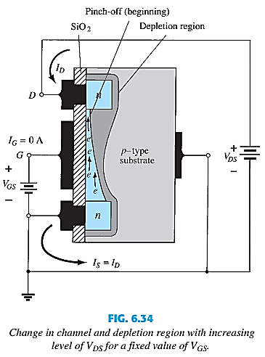
CONTINUED…

Slide 17
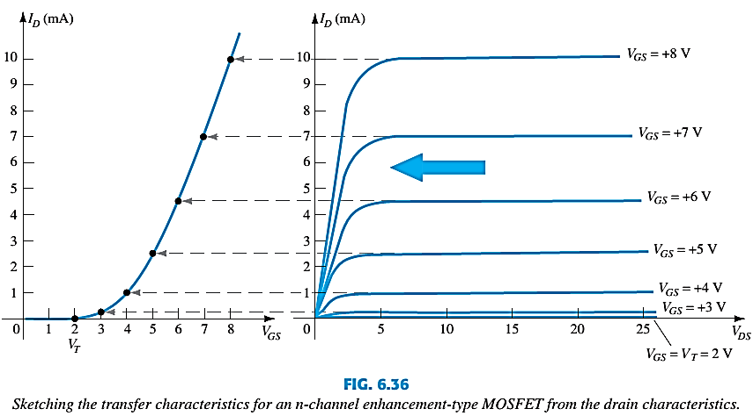
BASIC OPERATION
The Enhancement-type MOSFET only operates in the enhancement mode.
V_{GS} is always positive.
As V_{GS} increases, I_{D} increases.
But if V_{GS} is kept constant and V_{DS} is increased, then I_{D} saturates (I_{DSS}).
The saturation level, V_{DSsat} is reached.
Check this: http://www-g.eng.cam.ac.uk/mmg/teaching/linearcircuits/jfet.html

Slide 18
End of Lecture-4

